Slide 1
Convolutional Neural Networks (CNN)
Architecture, operations, and applications of CNNs — the backbone of modern computer vision.

Slide 2
Contents
01
02
What are Convolutional Neural Networks
The CNN Pipeline
03
04
The Convolution Operation
Stride ,Padding, Activation Function, Pooling,
Fully Connected Layer
05
06
Backpropagation Method
Batch Normalization and Dropout Method

Slide 3
What Are Convolutional Neural Networks?
Convolutional Neural Networks (CNNs) are a specialised class of deep learning models designed primarily to process and analyse visual data such as images and video.
Unlike conventional neural networks, CNNs are built to understand spatial structure — they treat input as a grid of values rather than a flat vector.
Automatic Feature Learning
Hierarchical Representation
End-to-End Learning
CNNs learn to detect edges, textures, and complex shapes directly from raw pixel data — no manual feature engineering required.
Early layers capture simple patterns; deeper layers combine these into abstract, high-level representations like faces or objects.
From raw pixels to final class label, the entire transformation is learned from data, making CNNs both powerful and flexible.

Slide 4
Feature Hierarchy Across Layers
The power of CNNs emerges from composing simple operations across depth. Each layer's receptive field grows, enabling the network to integrate context from larger regions of the image.
Layer 5+: High-Level Features
Layer 3–4: Mid-Level Features
Layer 1–2: Low-Level Features
Semantic concepts — faces, wheels, text. Directly discriminative for the target classification task.
Corners, curves, textures, and part-like structures. Combinations of low-level primitives.
Oriented edges, color gradients, blobs. Filters resemble Gabor wavelets — similar across many architectures.

Slide 5
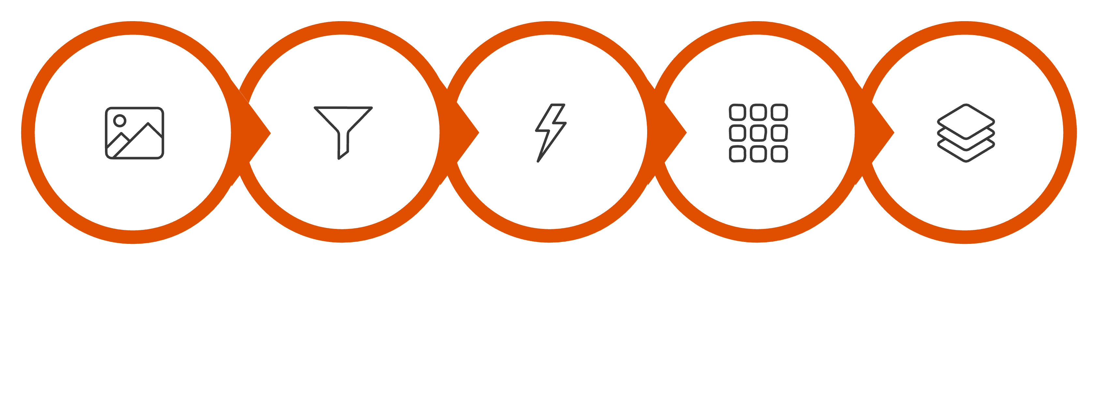
The CNN Pipeline
A CNN transforms a raw image into a class prediction through a series of structured operations. Each stage progressively learns
more complex and abstract features.
Fully Connected
Input Image
Convolution
ReLU
Pooling
This end-to-end pipeline enables the network to go from raw pixel values to confident class probabilities, with each intermediate stage building upon the representations learned by previous layers.

Slide 6
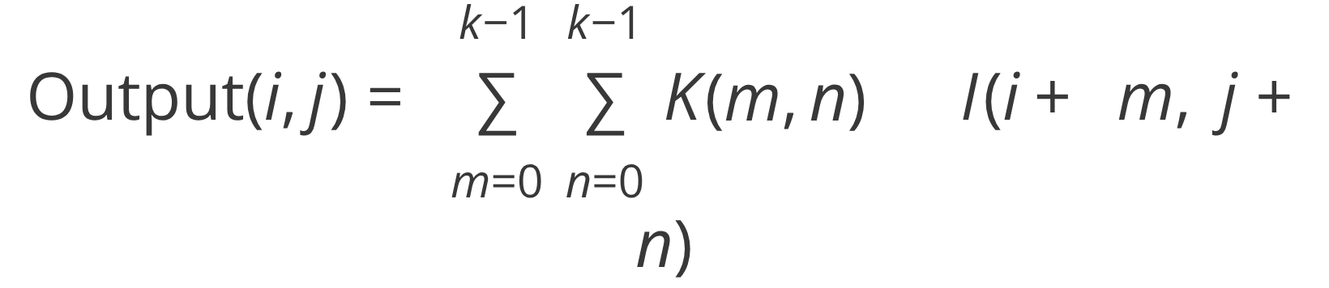

CORE OPERATION
The Convolution Operation
How It Works
Element-Wise Computation
A small learnable filter (kernel) slides across the input feature map. At each position, it computes the dot product between the kernel weights and the local patch of input values, producing a single scalar in the output feature map.
Where K is the kernel, I is the input, and k is the kernel size. For a 3×3 kernel, 9 multiply-accumulate operations produce each output value.
The filter weights are shared across all spatial positions — this is what gives CNNs their parameter efficiency and translation invariance.
Example: (-1×5) + (0×2) + (1×6) + (2×4) + (1×3) + (2×4) + (1×3) + (-2×9) + (0×2) = 5

Slide 7
The Convolution Operation

Slide 8

Stride
Stride defines how many pixels the filter moves at each step during convolution. It directly controls the spatial resolution of the output feature map and the computational cost of the operation.
Stride = 1
Stride = 2
Stride > 2
Fine-grained extraction. The filter moves one pixel at a time, producing a large feature map with high spatial resolution. Captures maximum detail but increases computation.
Downsampled output. The filter skips every other pixel, halving the feature map dimensions. Reduces computation and memory while still capturing dominant patterns.
Aggressive reduction. Used for rapid spatial compression. Less common in practice, but useful in certain architectures to replace pooling layers.
Output Size Formula: Output = ⌊(Input − Filter + 2×Padding) / Stride⌋ + 1

Slide 9
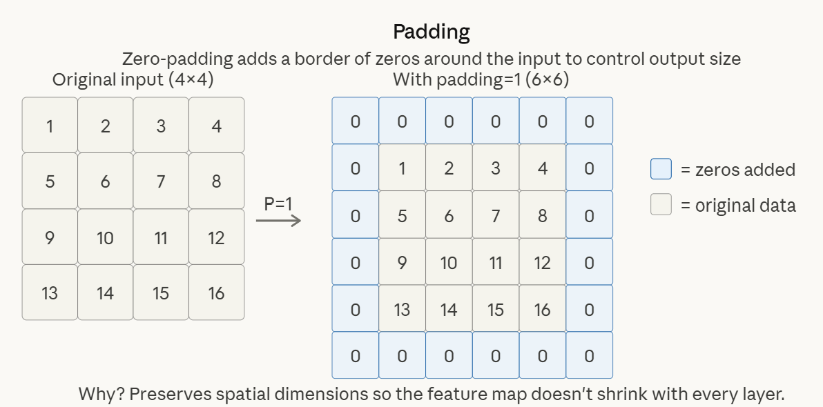
Padding
When a filter slides over an image, pixels at the border of the image are visited far fewer times than central pixels. Without padding, the spatial dimensions shrink after every convolution and border information is lost.

Slide 10
Activation Function: ReLU
After each convolution, an activation function is applied element-wise to the feature map. Without activation functions, the entire network would behave as a single linear transformation, no matter how many layers are stacked — fundamentally limiting its expressive power.
Rectified Linear Unit (ReLU)
Other Activation Functions
The most widely used activation function in CNNs. Its definition is elegantly simple:
Leaky ReLU: Allows a small gradient for negative values, preventing "dying ReLU" neurons.
Sigmoid: Maps output to (0,1) — useful for binary output layers.
All negative values are set to zero; positive values pass through unchanged. This introduces non-linearity while being computationally trivial to compute and differentiate.
Softmax: Converts logits to a probability distribution across classes — used in the final layer of classifiers.
Advantages of ReLU
Computationally efficient — no exponentials required
Mitigates the vanishing gradient problem in deep networks
Promotes sparsity — many neurons output zero

Slide 11
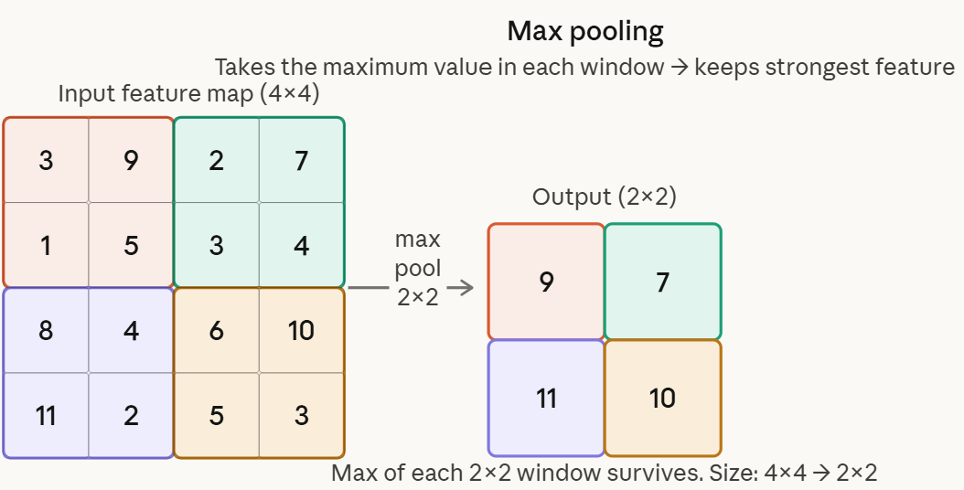
DIMENSIONALITY REDUCTION
Types of Pooling
Max Pooling
Selects the maximum value from each pooling window. This retains the strongest activation — the most prominent evidence that a particular feature is present in that region.
Most widely used pooling method
Effective for detecting whether a feature exists
Robust to small translations and distortions
Typical window: 2×2 with stride 2 (halves dimensions)
Practical Note: Max pooling is the default choice in most architectures. Global Average Pooling (GAP) is increasingly used in modern networks to reduce parameters and prevent overfitting.

Slide 12
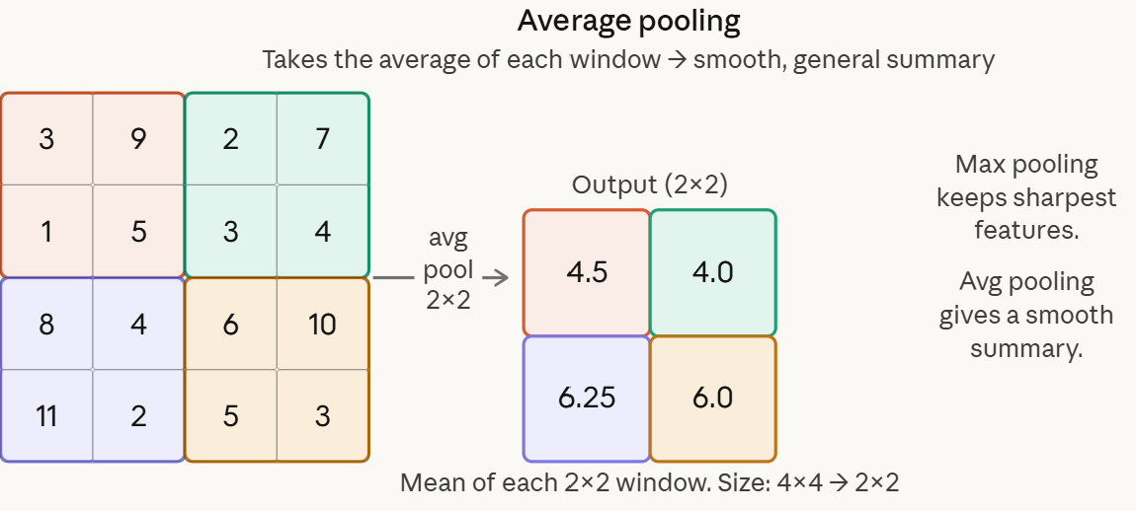
DIMENSIONALITY REDUCTION
Types of Pooling
Average Pooling
Computes the mean value across each pooling window. Produces a smoother, more distributed representation of the feature map by considering all activations equally.
Less aggressive than max pooling
Useful when global context matters more than peak activations
Common in final layers as Global Average Pooling (GAP)
GAP replaces fully connected layers in modern architectures

Slide 13
Fully Connected Layer
After a series of convolution, activation, and pooling operations, the spatial feature maps are flattened into a single 1D vector. This vector is then passed through one or more fully connected (dense) layers, where every neuron connects to every neuron in the adjacent layer.
Flatten
Dense Hidden Layer(s)
Output Layer
The final pooled feature maps (e.g., 4×4×64) are reshaped into a flat vector (e.g., 1024 values). This converts spatial representations into a format compatible with dense layers.
One or more fully connected layers with ReLU activation learn high-level combinations of the extracted features, capturing global relationships across the entire image.
The final dense layer produces one value per class. A Softmax activation converts these into a probability distribution — the model's confidence for each possible class label.

Slide 14
Feature Hierarchy Across Layers
The power of CNNs emerges from composing simple operations across depth. Each layer's receptive field grows, enabling the network to integrate context from larger regions of the image.
Layer 5+: High-Level Features
Layer 3–4: Mid-Level Features
Layer 1–2: Low-Level Features
Semantic concepts — faces, wheels, text. Directly discriminative for the target classification task.
Corners, curves, textures, and part-like structures. Combinations of low-level primitives.
Oriented edges, color gradients, blobs. Filters resemble Gabor wavelets — similar across many architectures.

Slide 15



Backpropagation Through Convolutions
CNNs are trained via stochastic gradient descent with backpropagation. Gradients flow backward through each operation — including convolution — to update every learnable filter weight.
Loss Function
Gradient of Convolution
Cross-entropy loss for multi-class classification. Penalizes confident wrong predictions most severely.
The gradient w.r.t. each kernel weight is the cross-correlation of the input patch with the upstream gradient — itself a convolution-like operation.
Weight Update
Because filter weights are shared across positions, gradients accumulate from every spatial location — this is what drives efficient generalization.
Each kernel weight updated by learning rate η times the gradient of the loss with respect to that weight.

Slide 16
Batch Normalization: Faster Convergence and Regularizer
What is Batch Normalisation?
How is it Different from Feature Scaling?
Batch Normalisation (BatchNorm) normalises the output activations of a layer across the current mini-batch during training.
For each feature dimension, it subtracts the
batch mean and divides by the batch standard deviation, then applies learned scale (γ) and shift (β) parameters.
Feature scaling (e.g. StandardScaler) is applied once, before training, to the raw input variables — it is fixed.
Batch Normalization is applied inside the network, after each layer, during every forward pass. It re-normalises activations dynamically at each layer, not just the inputs.
It also includes trainable parameters (γ, β) so the network can learn to undo the normalisation if needed.
Formula: x̂ = (x − μ_batch) / σ_batch, then scaled and shifted: y = γx̂ + β

Slide 17
Dropout
Dropout is a powerful regularization technique primarily used to prevent overfitting in deep neural networks, including Convolutional Neural Networks (CNNs).
How it Works
Random Deactivation: During each training iteration, dropout "turns off" a random subset of neurons (along with their connections) with a probability p (e.g., 0.5).
Thin Networks: This effectively forces the model to train on a different "thinned" architecture every time a gradient update occurs.
No Redundancy: By removing neurons at random, the network cannot rely on any single neuron or specific combination of features. This prevents co-adaptation, where neurons only work well in the presence of specific others.
2. Training vs. Inference
During Training: Neurons are randomly dropped. The remaining active weights are typically scaled by $1/(1-p)$ to maintain the expected sum of inputs.
During Testing/Inference: Dropout is turned off. All neurons are active, but their weights are scaled (or the outputs are already scaled from the training phase) to ensure the total signal strength matches what the model saw during training.
Typical dropout rates: p = 0.5 for fully connected layers, p = 0.1–0.2 for convolutional layers. Rarely applied after BN layers in modern architectures.

Slide 18
APPLICATIONS
Where CNNs Are Applied
Image Classification
Object Detection
Assign a single label to an entire image. The canonical task — benchmark: ImageNet top-5 accuracy.
Localize and classify multiple objects. Architectures: YOLO, Faster R-CNN, SSD.
Semantic Segmentation
Medical Imaging
Assign a class label to every pixel. Used in autonomous driving and medical imaging.
Detect tumors, diabetic retinopathy, and lung nodules — often matching radiologist accuracy.

Slide 19
Landmark CNN Architectures
Over the past decade, several milestone architectures have driven dramatic improvements in computer vision benchmarks. Each introduced novel design principles that shaped subsequent research and deployment.
AlexNet (2012)
GoogLeNet (2014)
First deep CNN to win ImageNet. Introduced ReLU, dropout regularisation, and GPU training. Sparked the deep learning revolution.
Introduced Inception modules — parallel convolutions at multiple scales. Drastically reduced parameters while improving accuracy.
1
2
3
4
VGGNet (2014)
ResNet (2015)
Demonstrated that depth matters. Used very small 3×3 filters stacked deeply. Achieved state-of-the-art with 16–19 layers.
Introduced skip connections (residual blocks) to solve the vanishing gradient problem, enabling networks with 50–152+ layers.

Slide 20
Key Takeaways
Convolutional Neural Networks represent one of the most significant advances in modern machine learning. Below are the essential concepts from this unit.
1
CNNs Automate Feature Learning
2
The Core Pipeline is Structured
Unlike traditional ML, CNNs learn edges, textures, and shapes directly from raw pixels — eliminating manual feature engineering entirely.
Every CNN follows the same fundamental sequence: Conv → ReLU → Pool → Flatten → Dense → Softmax. Each stage has a precise role in transforming raw data into predictions.
3
Hyperparameters Control the Trade-offs
4
Architectures Keep Evolving
Stride, padding, filter size, and pooling type are design decisions that balance spatial resolution, computational cost, and model capacity.
From AlexNet to ResNet, each generation introduced innovations — deeper networks, residual connections, multi-scale filters — that continue to inform state-of-the-art models today.

